Slide 1
COMP4036 Mixed Reality
Campus Adventure Game
A location-based mixed reality game that combines physical campus with digital interaction
Technology: Locative Media
Student Name:YuBin Jin
Student ID:20651978

Slide 2
01
Settings

Slide 3

Settings

Slide 4
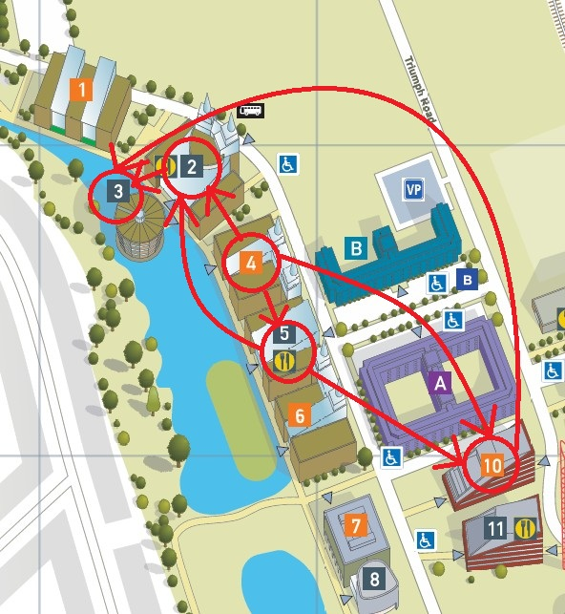
Settings
This is a simple illustration of the locations and routes that will appear in the game. The circles mark the locations. The starting point is from Building 4 - Computer Building, with options to move to Building 2 - Exchange Building, Building 5 - Canteen, Building 10 - YangFuJia Building. And the final destination is Building 3 - Library. The arrows represent the routes that can be chosen.

Slide 5
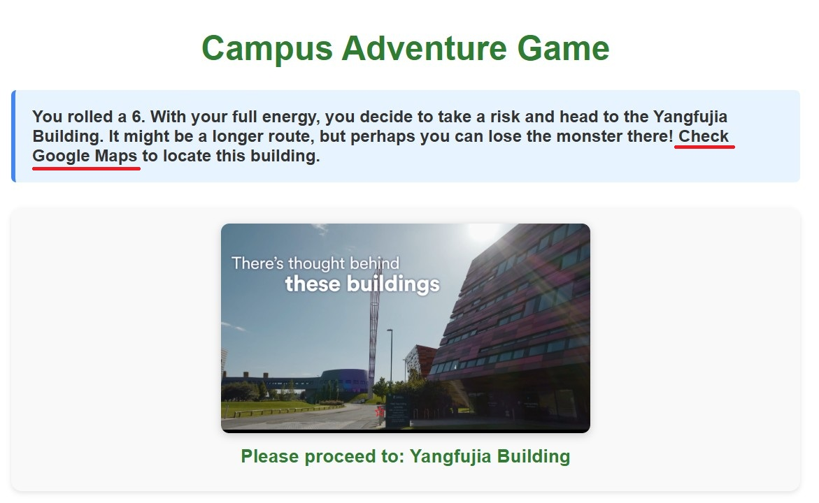

Settings

Slide 6
02
Idea Card

Slide 7
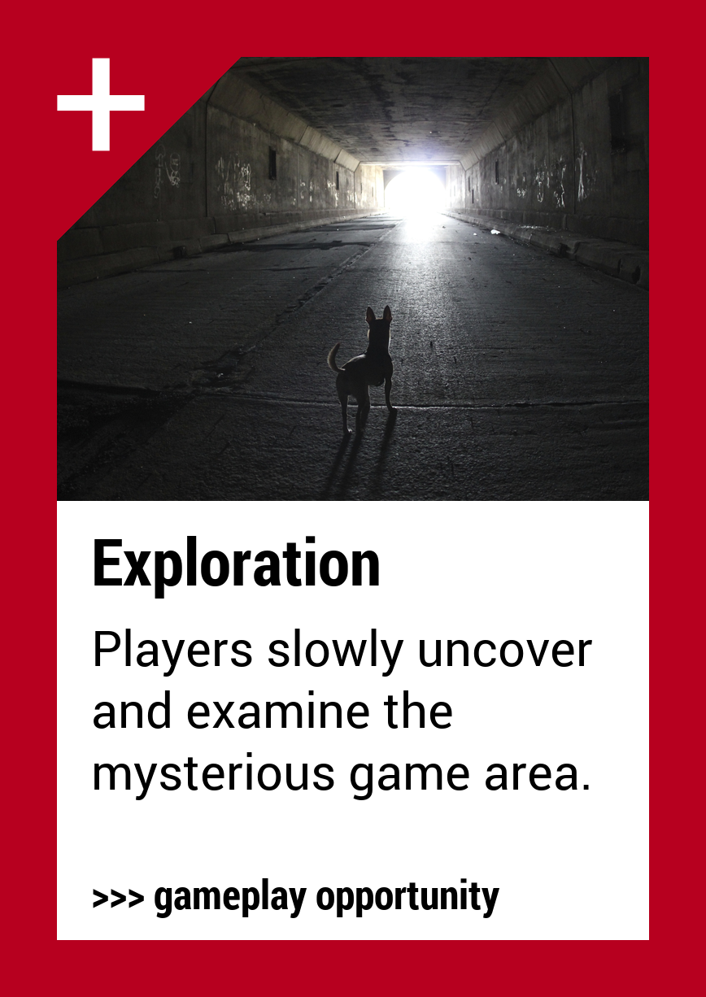
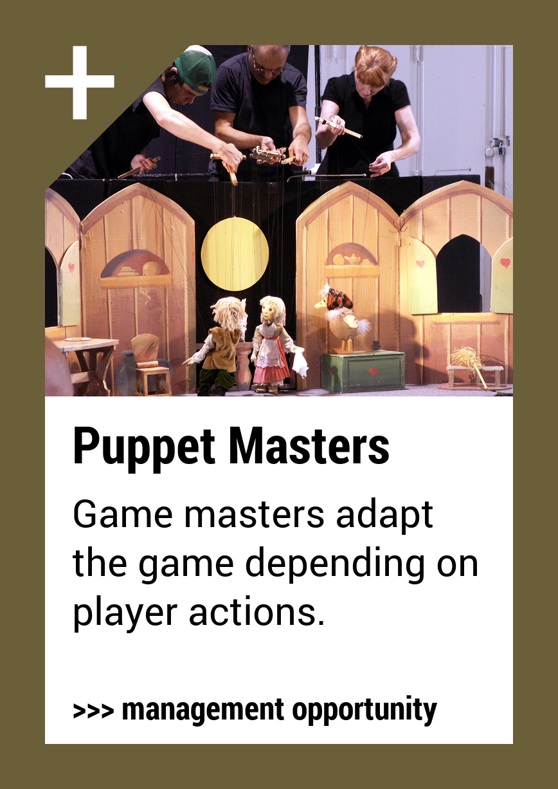
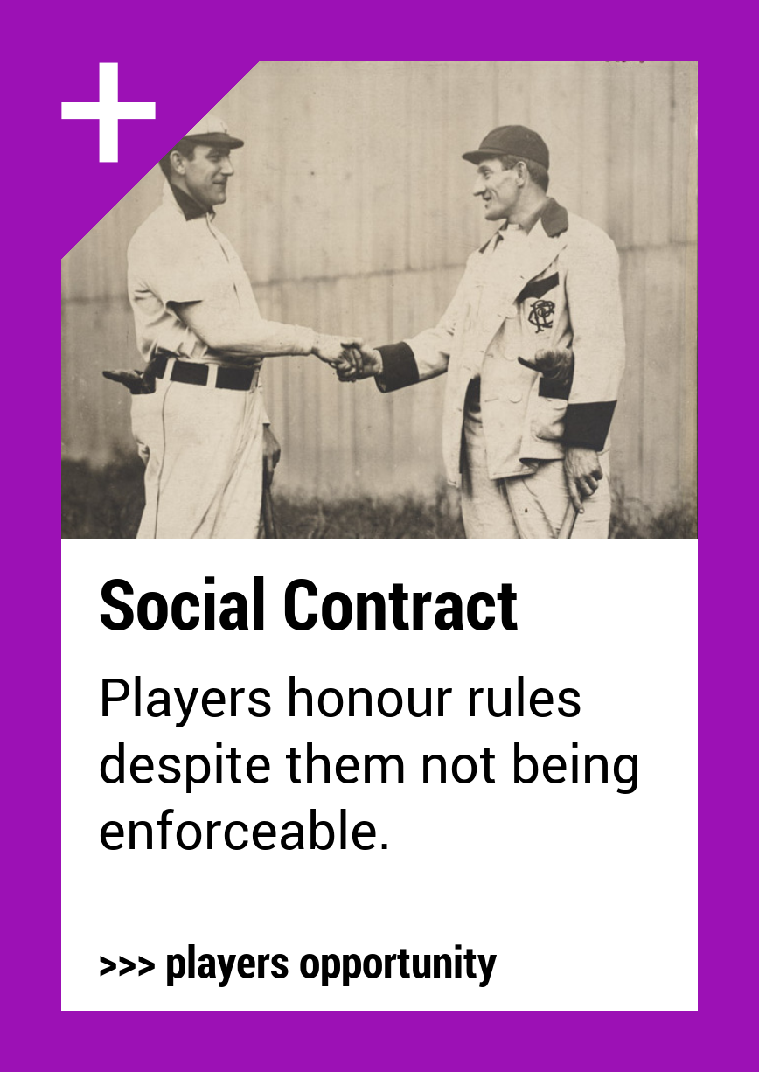
Idea Cards

Slide 8
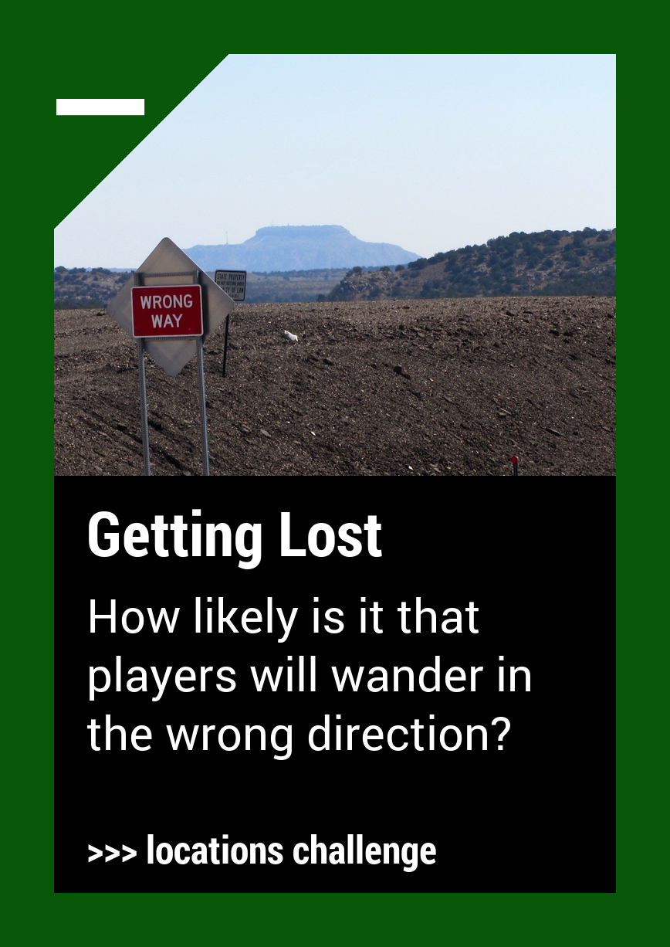
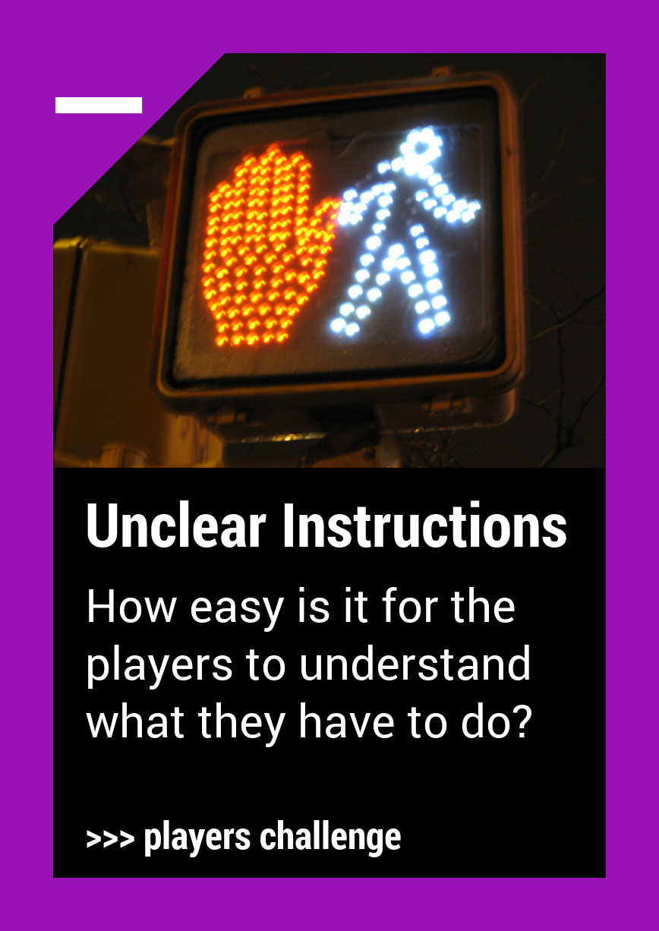
Idea Cards

Slide 9
03
Prototype

Slide 10
gamelogic.js
Game state management: use localStorage to store and read game data, the game state object contains information such as position, energy, points, etc. and saves this information automatically.
Game logic: dice roll function (rollDice); location update handling (handleLocationUpdate); game rules application (applyLocationRules, applyDiceRules); game reset (resetGame).
QR code scanning processing: initialising the scanner; processing scanning results; parsing QR code content in different formats; camera access control.
User Interface Updates: Update game status display; display destination pictures; manage dice animation effects; display game messages.
The code is all uploaded to github for viewing.

Slide 11
Video

Slide 12
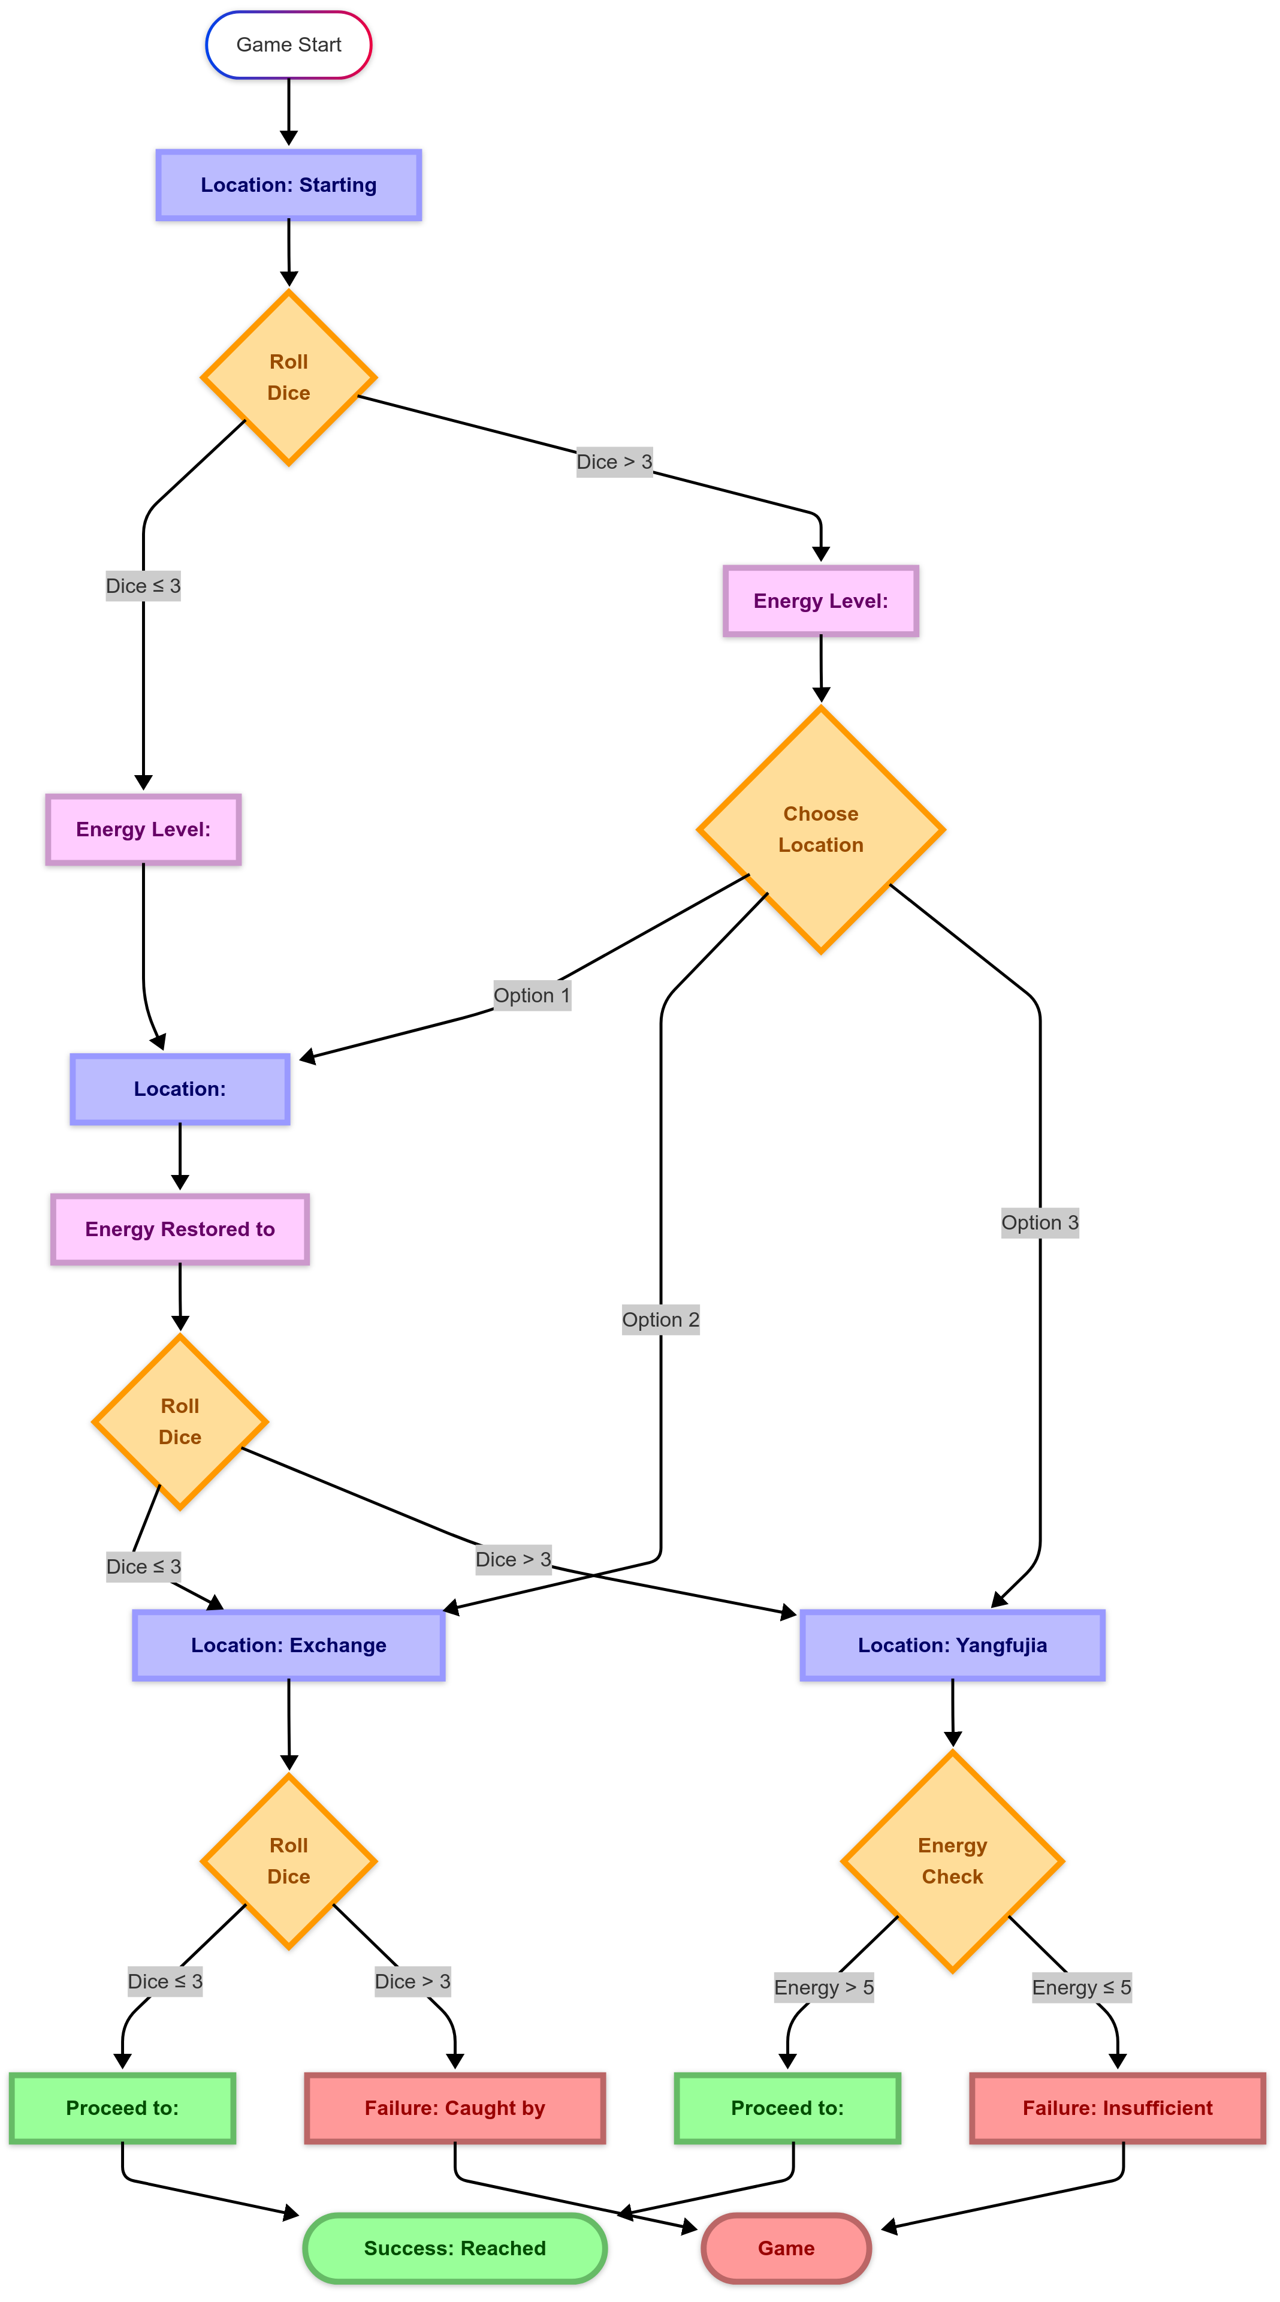
Flow Chart

Slide 13
Game Paths
Starting point: Computer Building
The player rolls the dice in the computer building:
- If points ≤ 3: the player must go to the canteen (energy value 0)
- If points > 3: the player has three choices (energy value is 5)
o Cateen
o exchange building
o yfj building
Class A Players: computer building → canteen
(Roll ≤ 3 from computer building, must go to canteen. In the canteen the energy level is restored to 10)
Path 1: Computer Building → canteen → Exchange Building
Roll ≤ 3 from the canteen and go to the exchange building. Roll the dice in the exchange building:
If points ≤ 3: Successfully ditch the monster and go to the library (victory)
If points > 3: the monster catches up with you (loss)
Path 2: Computer Building → canteen → yfj Building [Inevitable Successful Ending]
Roll > 3 from canteen and go to yfj building
Check energy value at yfj building:
Energy > 5 (currently 10): enough energy to go to the library (victory)
Energy ≤ 5 (this is not possible, as the energy from the canteen is 10)

Slide 14
Game Paths
Class B players:
Path 3: Computer Building → Exchange Building
Roll > 3 from the computer building and choose to go directly to the exchange building (energy value of 5). Roll the dice at the exchange building:
If points ≤ 3: Successfully ditch the monster and go to the library (victory)
If points > 3: the monster catches up with you (failure)
Path 4: Computer building → yfj building [Definite Failure Ending]
Roll > 3 from the computer building and choose to go directly to the yfj building (energy value of 5)
Check the energy value at the yfj building:
Energy value > 5 (this is not possible, as the energy from the computer building is 5)
Energy value ≤ 5 (currently 5): not enough energy to escape (failure)
Class C players:
If the player does not follow the previous hints at any step, the logic code for this game will uniformly make the player start over from the computer building.

Slide 15
04
Testing

Slide 16
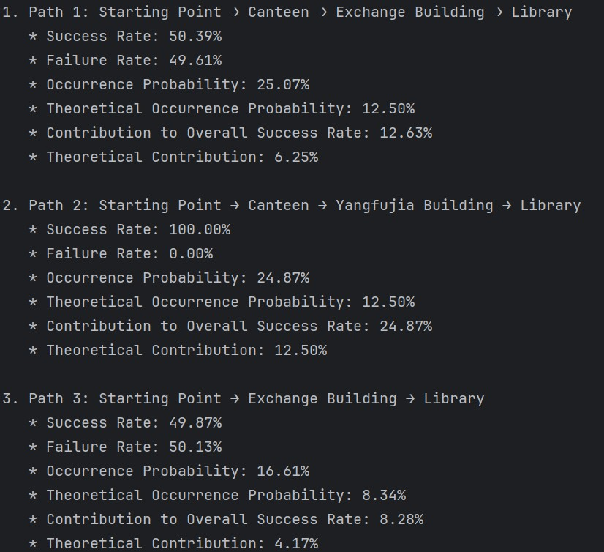
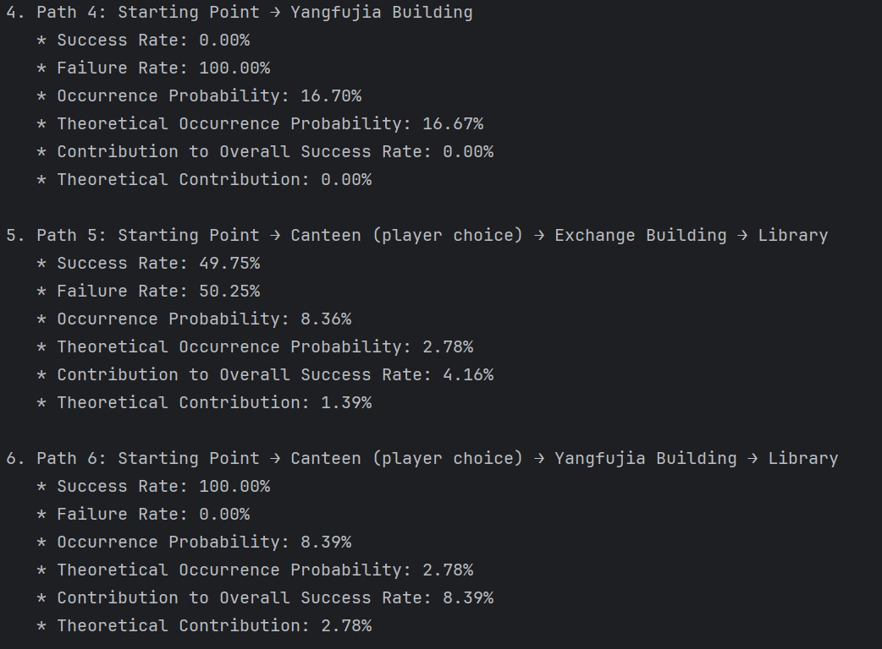
TEST Result

Slide 17
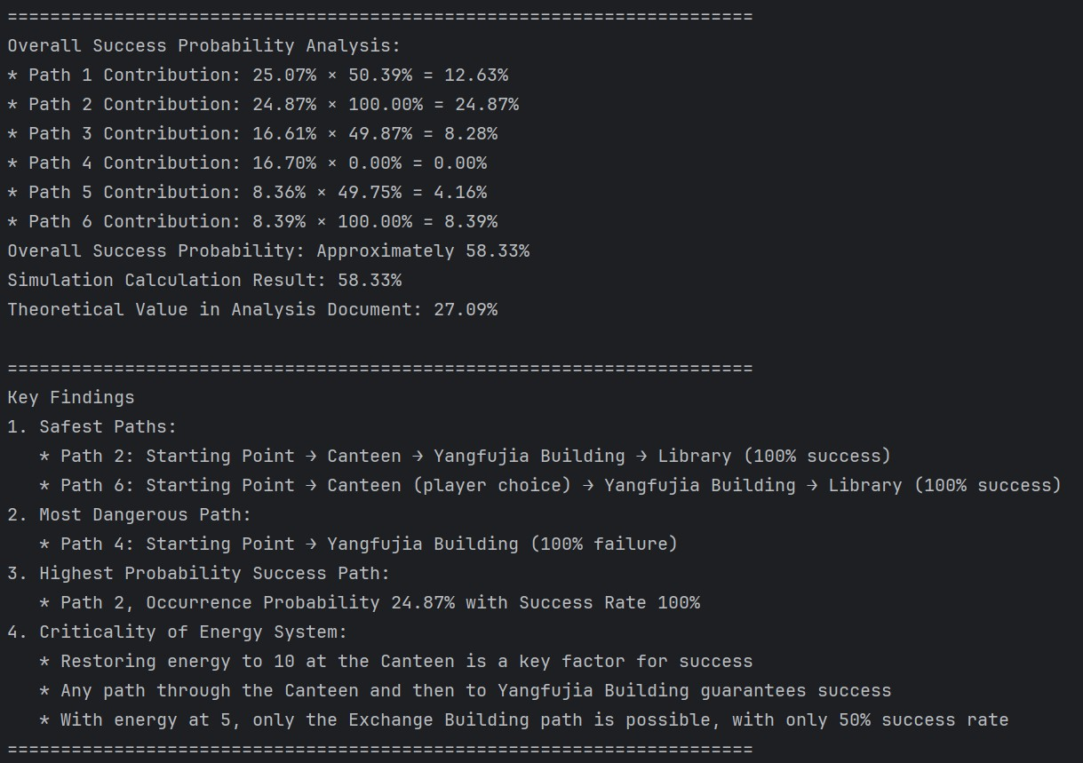
TEST Result

Slide 18
05
Reflection

Slide 19
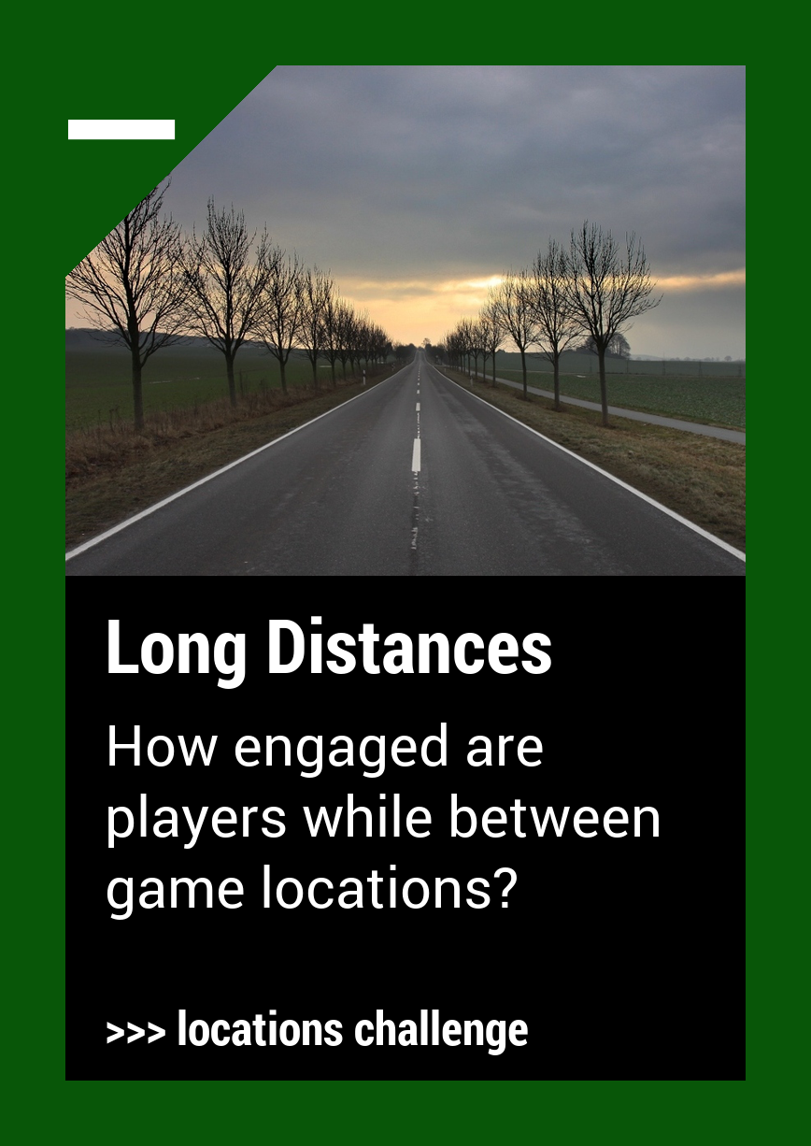
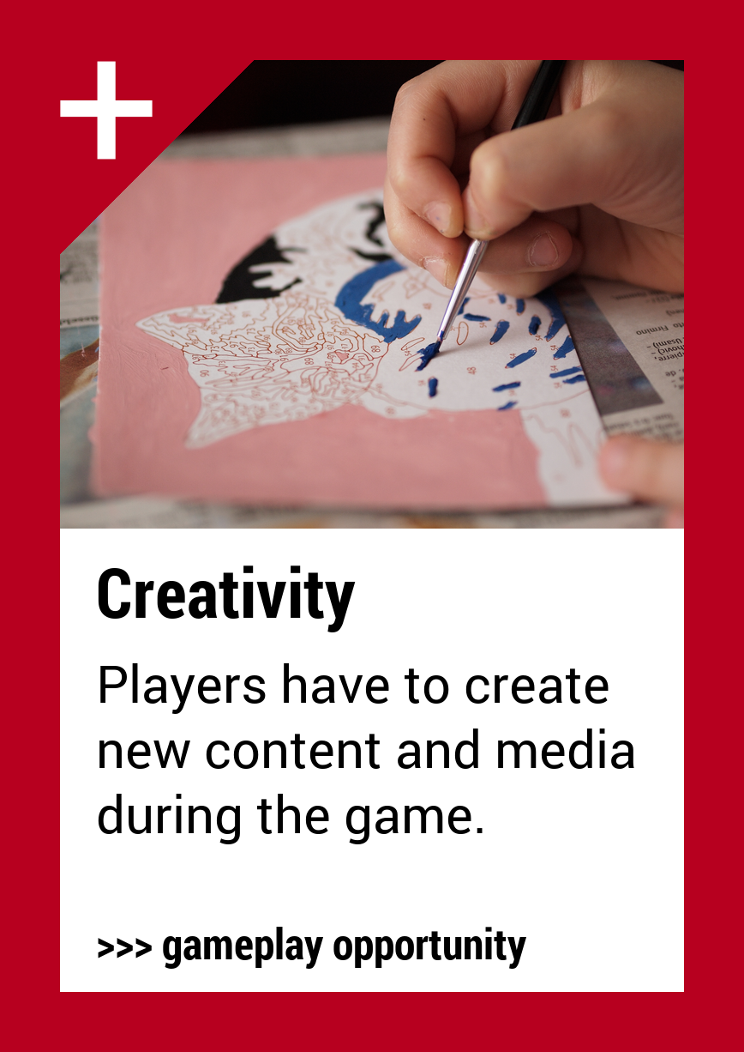
Reflection

Slide 20
Thanks!

